Slide 1
Cortex M4 Instructions Set
Girish S Kumar

Slide 2
Cortex M4 Instructions Set
Cortex M4 has
203 Instructions in general category
65 instructions related to FPU
1. Data Moving Instructions
2. Arithmetic Instructions
3. Logic Instructions
4. Shift and Rotate Instructions
5. Data Conversion Instructions
6. Bit-Field Processing Instructions
7. Compare and Test Instructions
8. Program Flow Control Instructions
9. Saturation Instructions
10. Exception Related Instructions
11. Sleep Mode Instructions
12. Memory Barrier Instructions
13. Miscellaneous Instructions
14. Unsupported Instructions

Slide 3
Application Program Status Register
There four Bits in this 32 Bit Register which is of interest, these are the upper most four bit (N, Z, C, V). These are called flags which are set and rest based on the result of the instructions executed.
Flag Name | How it is set
N -Negative Flag | When the result is in 2-compliment signed integer and result is –ve number this bit will be set to 1
V - oVerflow Flag | For an addition of sub, V is set to 1 if signed overflow occurred when the operands and results are two compliment signed integers
Z - Zero Flag | When the result of an operation results in all zeros (all 32 bits are zeros)
C – Carry Flag | Addition : If the addition produces a carry (unsigned overflow) this bit is set to 1, Subtraction : This bit is set to 0 of subtraction produced a borrow that an unsigned over flow and 1 otherwise For non add/sub operation that uses a shift operation, C is set o the last bit shifted out of the value by the shifter For other non add/sub operation this bit is left unchanged

Slide 4

Data Moving instructions
Instruction | Function | Impact on APSR
MOV Rd, Rt | Copy Rt to Rd | No flags are impacted
MOVS Rd, Rt | Copy Rt to Rd & Update APSR flag | N flag is set to , Rd[31]
MOV Rd, #Offset | Copy immediate Offset to Rd | No flags are impacted
MOVS Rd, #Offset | Copy Offset to Rd and update APSR | N flag is set to , Rd[31]
MOVW Rd, #Imm16 | Copy a 16-bit constant into bottom half of a register, implicitly zeroing the top 16 bits of the target register | No flags are impacted
MOVT Rd, #Imm16 | Copy a 16-bit constant into the top half of a given register without altering the bottom 16 bits | No flags are impacted

Slide 5
Data moving Instruction
Instruction | Function | Impact on APSR
MRS Rd, R_{special} | Copy the contents of a special register (APSR, APSR, IPSR, EPSR, IEPSR, IAPSR, EAPSR, PSR, MSP, PSP, PRIMASK, BASEPRI, BASEPRI_MAX,FAULTMASK, or CONTROL) to a general-purpose register. | No flags are impacted
MSR , R_{special}, Rt | Copy the contents of a general-purpose register into the specified special register register (APSR, APSR, IPSR, EPSR, IEPSR, IAPSR, EAPSR, PSR, MSP, PSP, PRIMASK, BASEPRI, BASEPRI_MAX,FAULTMASK, or CONTROL) | Flags are impacted based on the value of Rt
MVN Rd, Rt | The MVN instruction takes the value of Operand2, performs a bitwise logical NOT operation on the value, and places the result into Rd. | MVNS will impact the flags base d value Z and N

Slide 6

Arithmetic Instructions
Instruction | Function | Impact to APSR
ADD{S} {Rd}, Rn, Operand2 | Rd= Rn+Operand2 (or Rn= Rn+Operand2) | NZVC
ADD{S} {Rd}, Rn, Imm12 | Rd=Rn +Imm12 (or Rn=Rn+Imm12) | NZVC
ADC{S} {Rd}, Rn, Operand2 | Add with Carry Rd= Rn+ Operand2 +Carry | NZVC
SUB{S} {Rd}, Rn, Operand2; | Rd=Rn-Operand2 | NZVC
SUB{S} {Rd}, Rn, Imm12; | Rd=Rn-Imm12 | NZVC
SBC{S} {Rd}, Rn, Operand2; | Subtract with carry Rd= Rn-Operand2 – Carry | NZVC
RSB{S} {Rd}, Rn, Operand2; | Rd= Operand2-Rn | NZVC
RSB{S} {Rd}, Rn, Rm; | Rd = Rm - Rn | NZVC
MUL {Rd}, Rn, Rm; | Rd = Rn × Rm | NZVC

Slide 7
Arithmetic Instructions
Instruction | Function | Impact to APSR
MLA Rd, Rn, Rm, Ra; | Rd = Rn × Rm + Ra | NIL
MLS Rd, Rn, Rm, Ra | Rd = Ra- Rn×Rm | NIL
SDIV {Rd}, Rn, Rm | Signed division Rd = Rn/Rm | NIL
UDIV {Rd}, Rn, Rm | Unsigned division Rd = Rn/Rm | NIL

Slide 8
Restrictions
MUL{S}{cond} {Rd,} Rn, Rm ; Multiply
MLA{cond} Rd, Rn, Rm, Ra ; Multiply with accumulate
MLS{cond} Rd, Rn, Rm, Ra ; Multiply with subtract
Thumb instructions are either 16-bit or 32-bit, and are aligned on a two-byte boundary. 16-bit and 32-bit instructions can be intermixed freely. Many common operations are most efficiently executed using 16-bit instructions. However:
Most 16-bit instructions can only access eight of the general purpose registers, R0-R7. These are known as the low registers.
A small number of 16-bit instructions can access the high registers, R8-R15.
Many operations that would require two or more 16-bit instructions can be more efficiently executed with a single 32-bit instruction. The ARM and Thumb instruction sets are designed to interwork freely
MULS is implemented as 16 Bit instruction and hence access is limited to low registers

Slide 9
MULS
AS shown by
Debugger
0x08000200 4350 MULS r0,r2,r0
How the hex instruction is made
MULS r0, r2, r0
‭0100 0011 0101 0000‬
4 3 5 0
How the OP-code and registers are combined
0100001101 010 000‬ MULS r2 r0

Slide 10

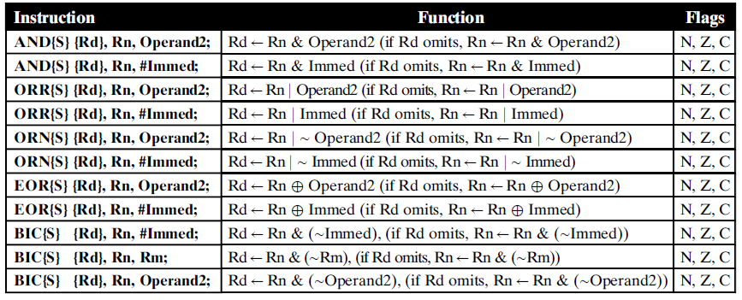
Logic Instructions

Slide 11
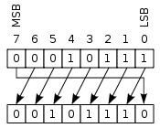
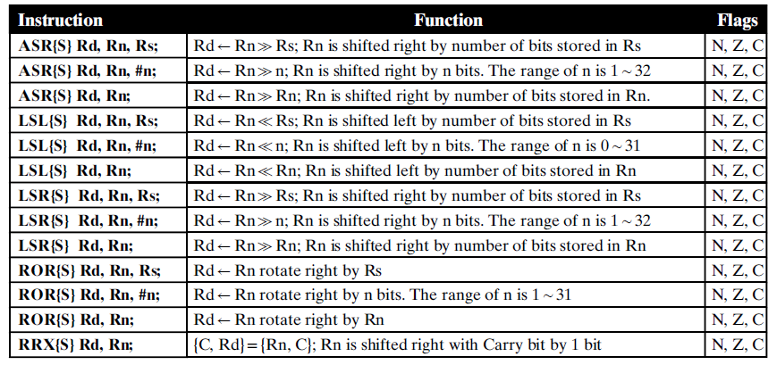
Shift and Rotate Instructions

Slide 12
Compare and Test Instructions
The Cortex-M4 processor provides compare and bit testing instructions. These
instructions can be use to make comparisons between registers and between
register and immediate data. The comparison result is used to update the condition codes
in the flag bits, but the result is not reserved
Instruction | Operation | Flags
CMP R0, R1; | CMP R0, R1 is to compare the content of R0 with the content of R1 | if R0 > R1 (N = 0), if R0 <R1 (N =1), if R0 = R1 (Z = 1) and (N = 0)
CMN R2, Operand2 | The CMN instruction adds the value of Operand2 to the value in Rn. This is the same as an ADDS instruction, except that the result is discarded. Note: ADDS R2, R1, Adds R2 with R1 and writes the result to R2 and update the condition flags, in case of CMN the addition takes place , condition flags will be updated based on results but the results will be discarded

Slide 13
Compare and Test Instruction
Instruction | Operation | Flags
TST R0, 0x101 | The TST instruction performs a bitwise AND operation on the value in Rn and the value of Operand2. This is the same as the ANDS instruction, except that it discards the result. | update the N and Z flags according to the result
TEQ R2, 0x80 | is to test whether the content of the R1 is equal to 0x80. | The flag bits Z and N will be affected based on the running result.

Slide 14
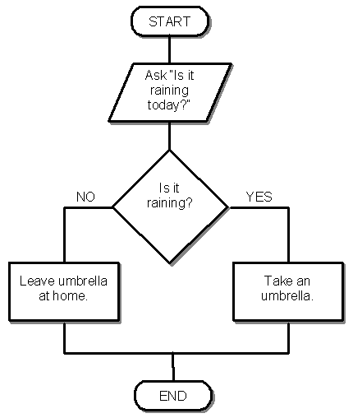
Controlling the Flow of executions
The Cortex-M4 processor provides 10 program branch and control instructions.

Slide 15
Flow Control
1. Unconditional Branches
2. Conditional Branches
3. Compare and Branches
5. Conditional Executions (If-Then or IT)

Slide 16
Most Commonly Used loops
While Loops
For Loops
Do – While Loops

Slide 17
If –then-else Structure
In CORTEX M4, there is instruction IT which is used for building a
If then else block The format is
ITxyz condition
xyz are the fields specify either the THEN
Block or ELSE Block, for example
ITTE LT
This mean there are two THEN instructions
And one ELSE instruction and the condition
To be checked is LT which means N != V in
APSR.

Slide 18
Rule for IF-THEN-ELSE
The condition field must be one of the fields listed in following table, except Always.
The first statement following the IT instruction must be the true-then-execute case (THEN).
The number of T’s and E’s in the IT instruction itself should match the
number of THEN and ELSE instructions in the block. If you specify an
instruction such as ITTEE, there should be two THEN instructions and two ELSE instructions following the IT instruction.
Branches to any instruction in the IT block are not permitted, apart from those performed by exception returns.
Any branches used in an IT block must be the last instruction in the block.
The ELSE condition must be the inverse of the THEN condition. If you
refer to following table again, you will notice that these two fields differ only in the LSB of the encoding. In other words, GE, which is 1010, is the inverse of LT, which is 1011.

Slide 19
Example of IF-then-else
AREA appcode, CODE, READONLY
export __main
ENTRY
__main function
CMP r6, #8
ITE LT
LSLLT r6 , r6, #1 ;
MOVGE r6, #2 ;
stop B stop ; stop program
endfunc
end

Slide 20
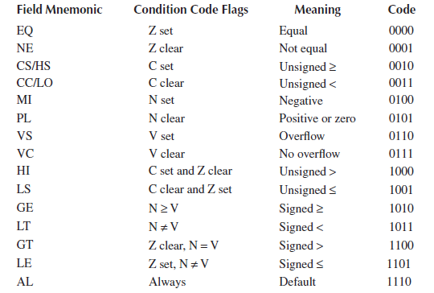
Conditional Code and their meaning

Slide 21
Class Exercise-1
Implement the following on Cortex M4
if (r2 != r7)
r2 = r2 − r7;
r2 = 0 ;
else
r2 = r2 + r4;
r4 = 0

Slide 22
Assignment- Q3
Here is C program to find GCD of two numbers
while (a != b)
{
if (a > b)
a = a – b;
else
b = b – a;
}
Re-Write this for CORTEX –M4

Slide 23
Class Exercise-3
Can do nested IF-Then else in CORTEX –M4 ?
Try it out on your simulator ….

Slide 24
Doing Modulus operation
The MLS instruction is similar to MLA, but it subtracts the product from the third operand.
This makes it suitable for finding the remainder of a division (this is also called a modulo or modulus operation).
Getting the remainder of a division:
udiv rT,rA,rB /* rT = rA / rB (example: 1 = 17 / 10) */
mls rT,rT,rB,rA /* rT = rA - rT * rB (example: 7 = 17 - (1 * 10)) */
Example:
udiv r0,r3,r2 /* [2..12] r0 = r3 / r2. */
mls r1,r0,r2,r3 /* [2] r1 = r3 - r0 * r1 */

Slide 25
Class Exercise-4
Given a number find out whether it is even or ODD in Cortex M4

Slide 26
Class Exercise-5
On you Hardware board find out how you can input a number either through key board or through some kind of sensor and decide whether that is even or ODD

Slide 27
Assignment Due on
Implement Fibonacci series using Cortex M4
2 Given three number find the largest of the three using Cortex M4
3. Here is C program to find GCD of two numbers, Re-Write this for CORTEX –M4
while (a != b)
{
if (a > b)
a = a – b;
else
b = b – a;
}

